Slide 1





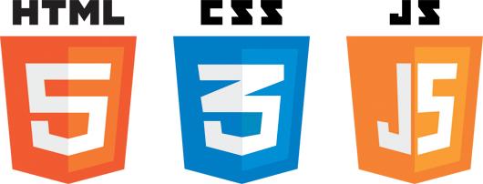

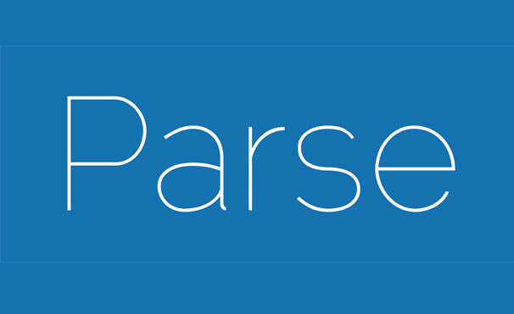

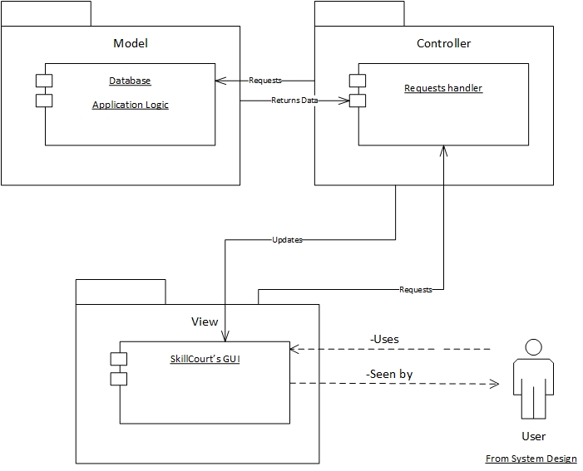
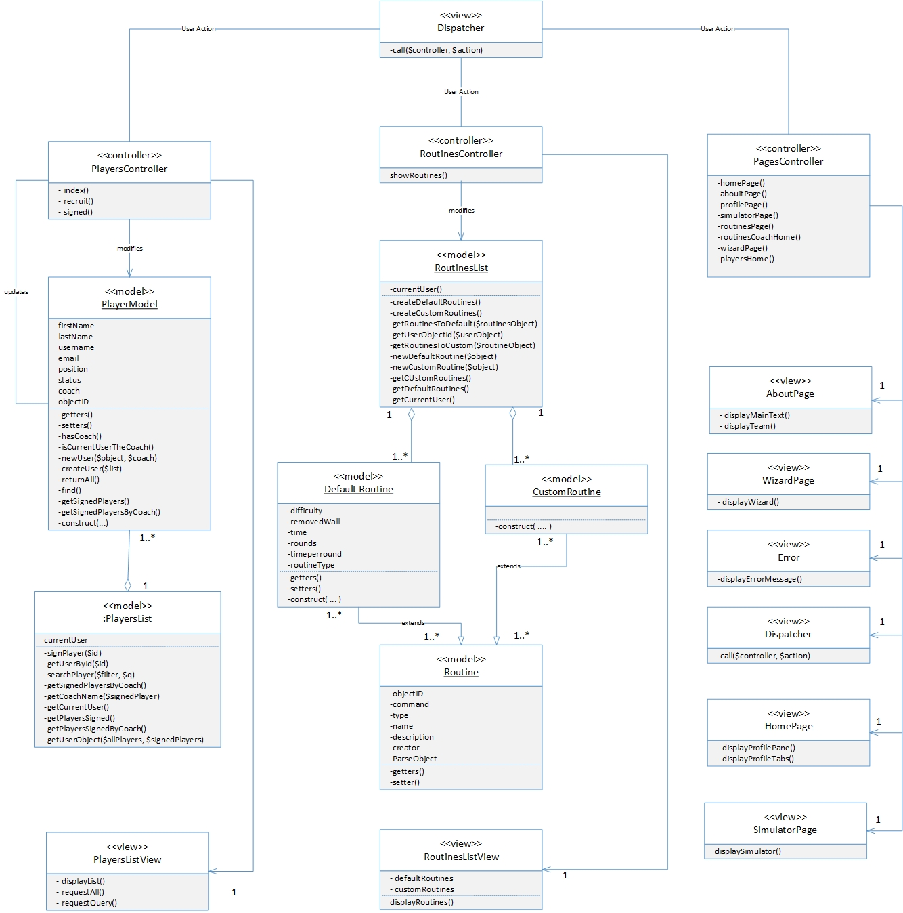
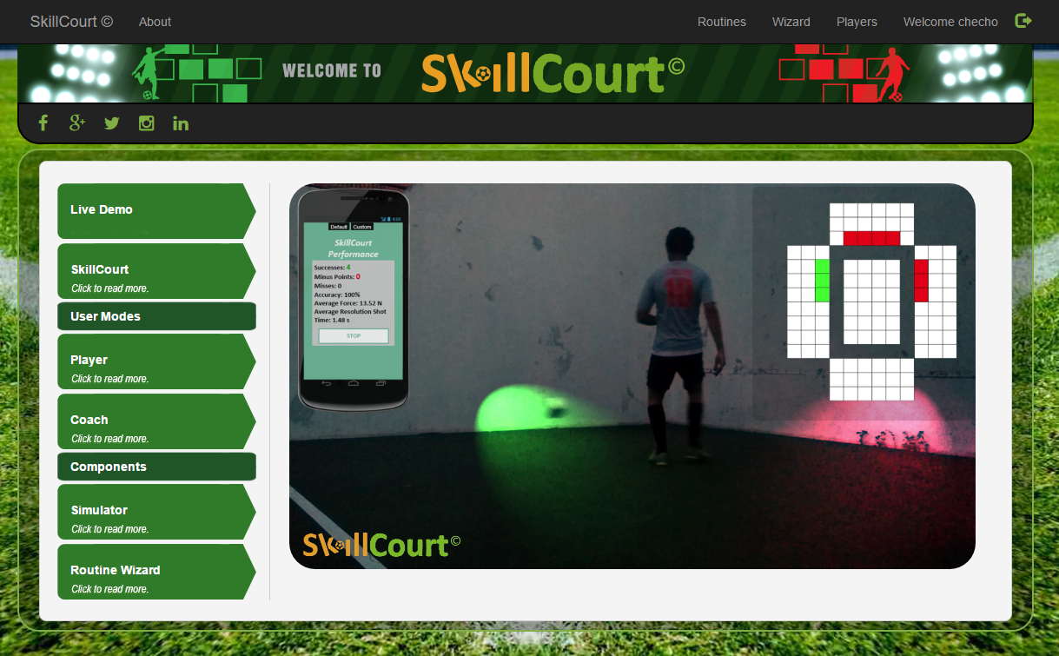
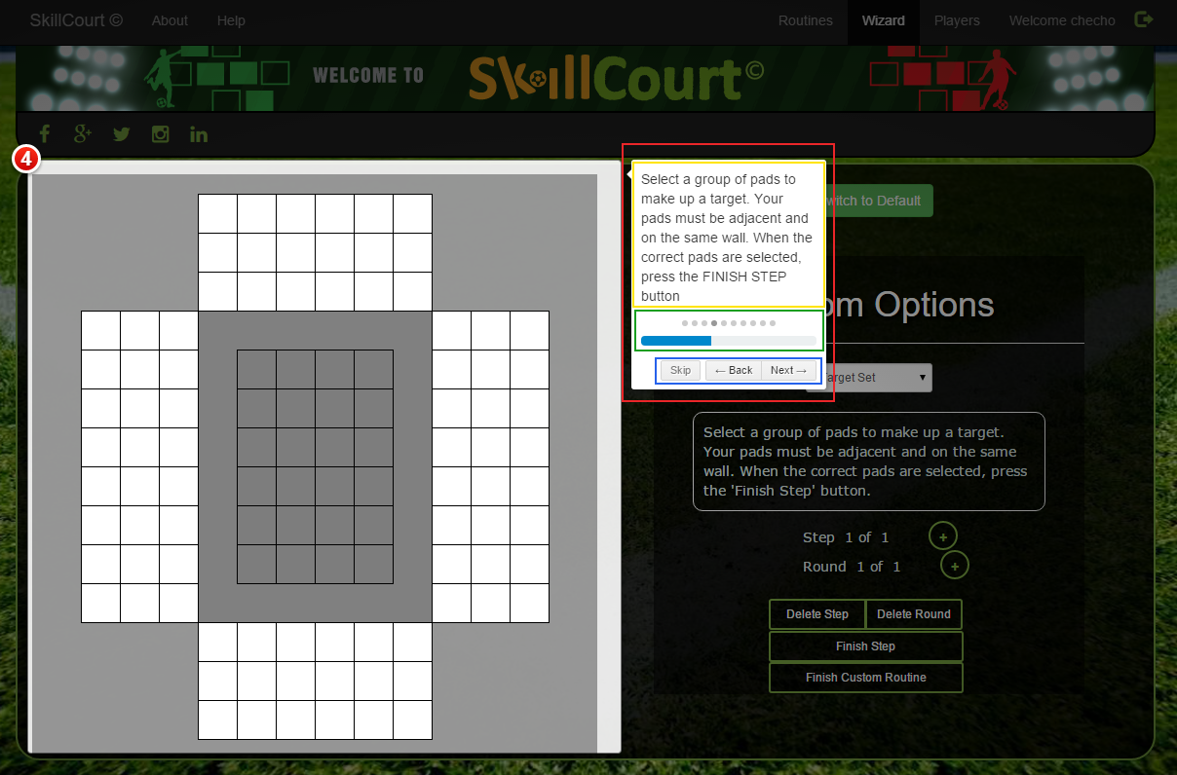
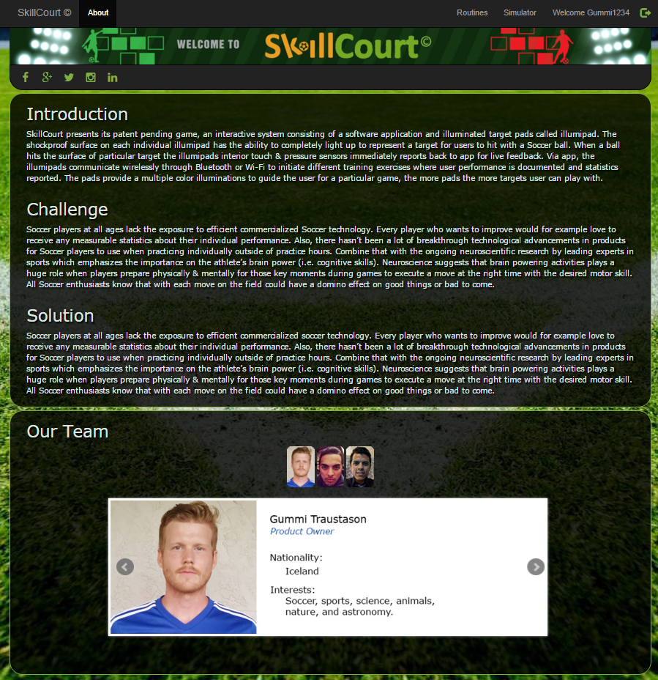
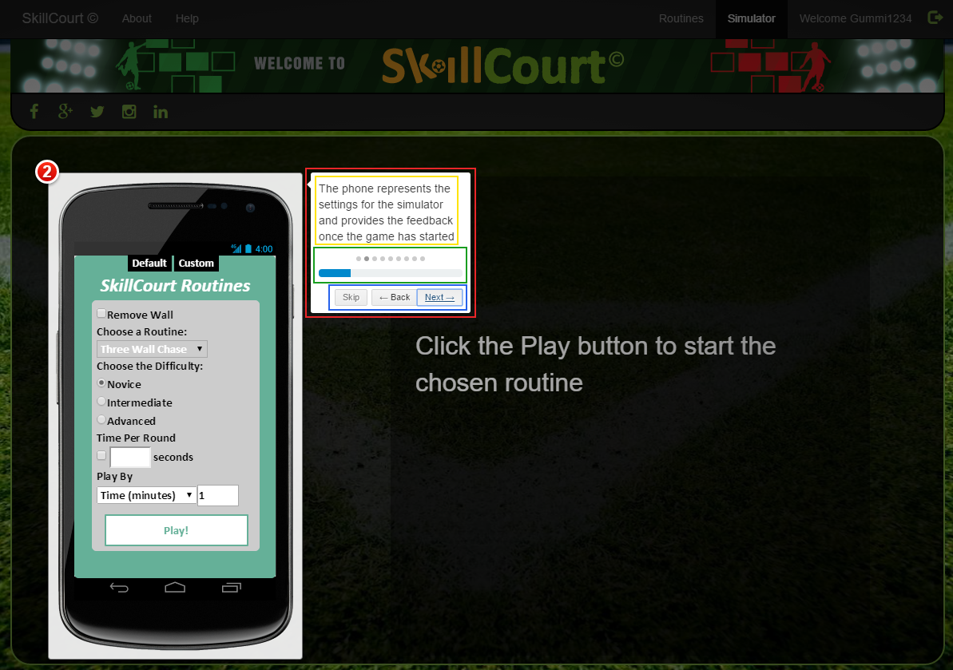
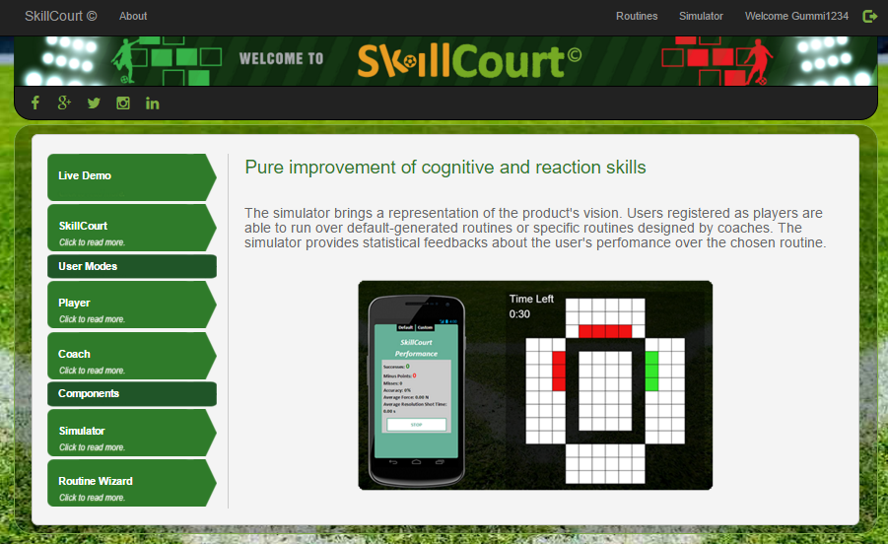
School of Computing & Information Sciences
Senior Project, 2015, Fall
SkillCourt V.3
Student: Sergio Saucedo, Florida International University
Mentor: Guðmundur Traustason, Jaime Borras
Instructor: Masoud Sadjadi, Florida International University
Problem
Current System
Requirements
Soccer attracts people from all ethnicities and backgrounds. Most people who enjoy playing the sport, lack an interactive training facility where they can improve their soccer skills as well as have fun while they do it.
SkillCourt aims to solve this problem, since you do not require a highly qualified training staff to help you develop your soccer skills. With the help of SkillCourt, players as well as coaches will benefit from this solution. It will provide its users the ability to improve their skills, as well as sharpen a coach’s ability to design soccer drills. These routines will showcase the ability of cognitive sports learning as well as an adaptation to a whole new level of training.
The current system has enhanced visuals and interfaces and comprehensive interactive guides that improve user experience in the use of the Simulator and Routine Wizard.
Interactive step-by-step guides explains the usability of the product and real-life demonstration shows the purpose and vision of SkillCourt.
First-Time Users can grasp SkillCourt’s concept with an interactive intro showing its main components (Simulator, Wizard, Type of Users, and real-life demonstration)
Player-Users are able to request help for a detailed interactive guide explaining the usability of the simulator.
Coach-Users are able to request help for a detailed interactive guide explaining the routine creation wizard.
Home and About pages can be more dynamic, making it more visually appealing to its users.
System Design
Object Design
Implementation
Simulator and Wizard Interactive Guides: written in Intro.js, a JavaScript based language for website intros.
Interactive Home/About Summary: written in HTML with jQuery BXSlider for customized transitions.
SkillCourt Website: Developed and improved using HTML, CSS, JavaScript, PHP and jQuery.
Real-Life Video Demonstration: Edited using Adobe Premier CS6 with visual effects to show SkillCourt’s Pad vision.
The SkillCourt system incorporates an MVC architecture in its website as well as the App-Pad-Simulator subsystem.
Verification
Screenshots
Summary
Testing on the system was performed manually by mentors as well as team members. Interactive guides and features were tested as they were completed. Sunny day and rainy day test cases were run where applicable.
QUnit, a JavaScript Unit Testing Framework, was also implemented in the testing of JavaScript code used for tutorial guides.
The new SkillCourt system addresses many of the shortcomings of the prior version:
It offers interactive tutorial guides for both Player and Coach-Users.
It provides a much better user experience by the use of upgraded visuals, interfaces, views and interactive content.
It offers proof of concept for what SkillCourt’s product and vision is.
Acknowledgement
The material presented in this poster is based upon the work supported by Guðmundur “Gummi” Traustason, Jaime Borras, and Masoud Sadjadi .
I am thankful to the help that I received from my team member Wilfrido Rodriguez and his contributions.

